Slide 1
CSE 351 Project #2:
Titanic - Who will survive?
– Zian Shang

Slide 2
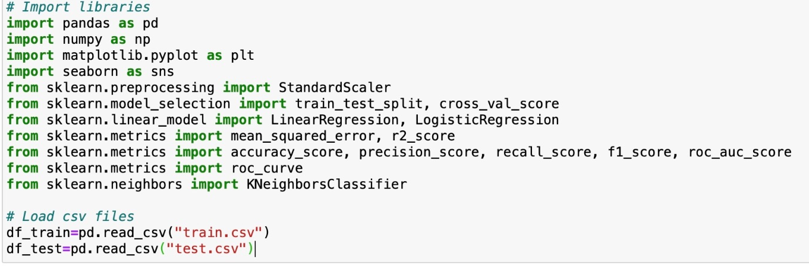
Libraries & datasets

Slide 3
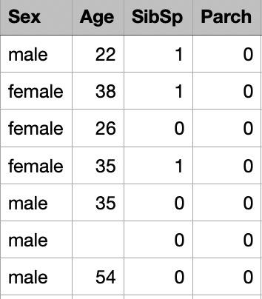
Clean Dataset
Imputing missing age values

Slide 4
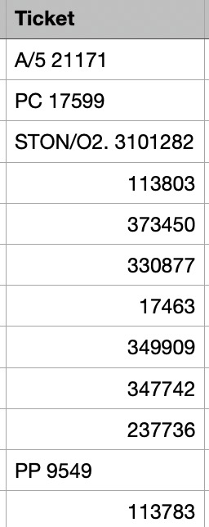
Clean Dataset
???
2. Extract 'Ticket' number from 'Ticket' column

Slide 5
Clean Dataset
3. Ensure columns retain correct data types

Slide 6
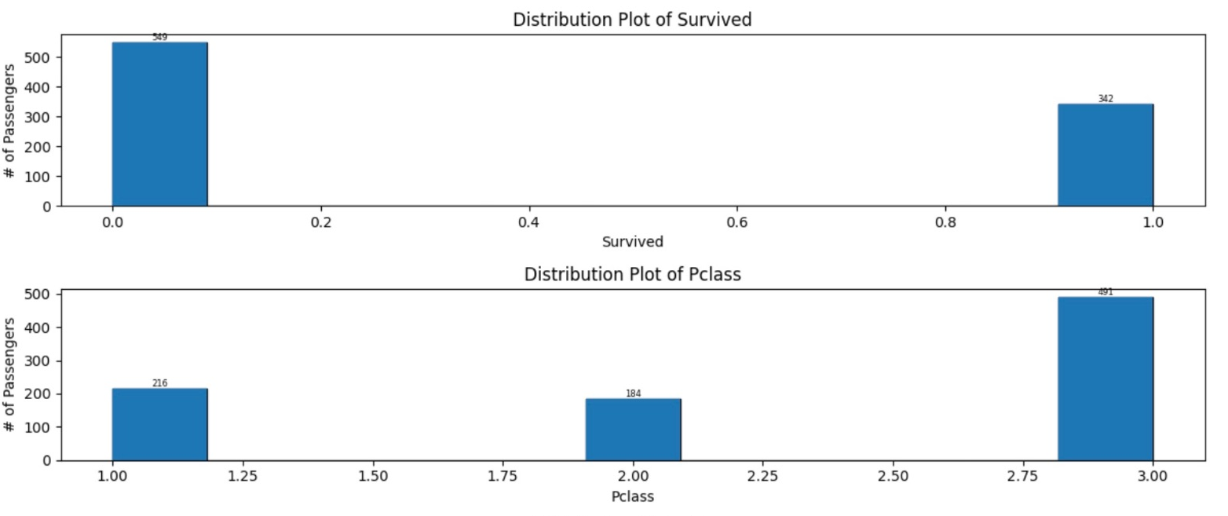
Clean Dataset
4. Removing outliers?

Slide 7
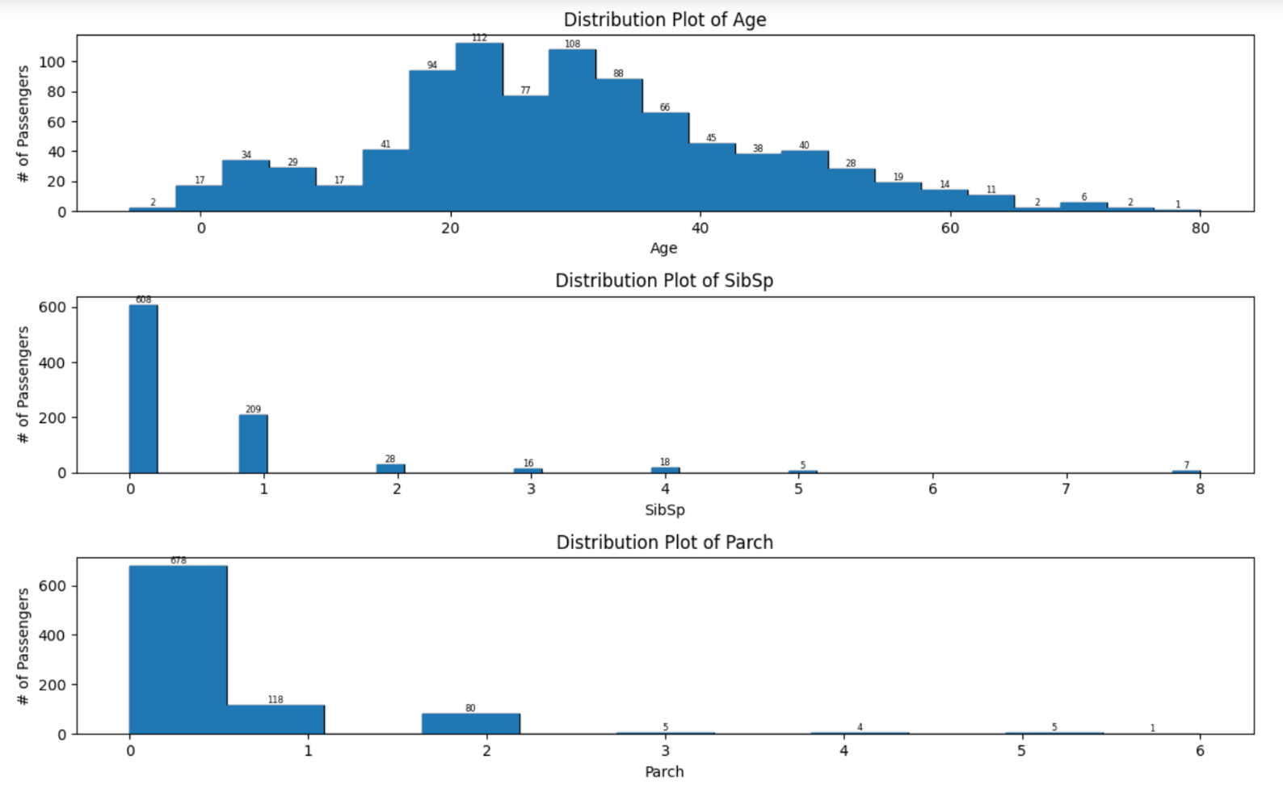
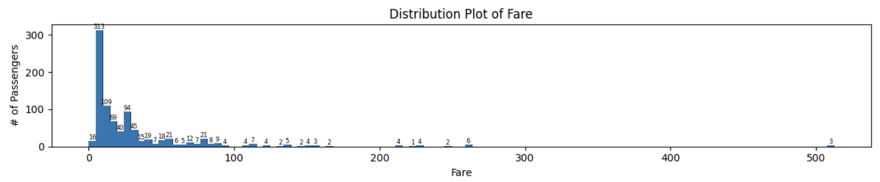
Clean Dataset
4. Removing outliers?

Slide 8
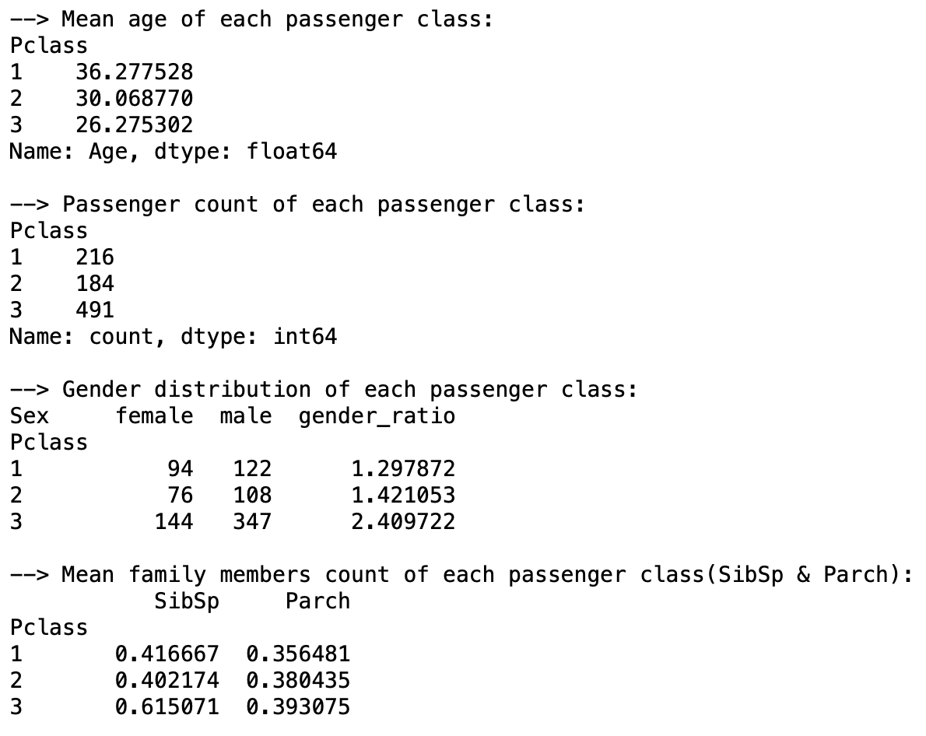
Socio-economic Status Exploration
Group the passengers by ‘Pclass’ and compute statistics

Slide 9
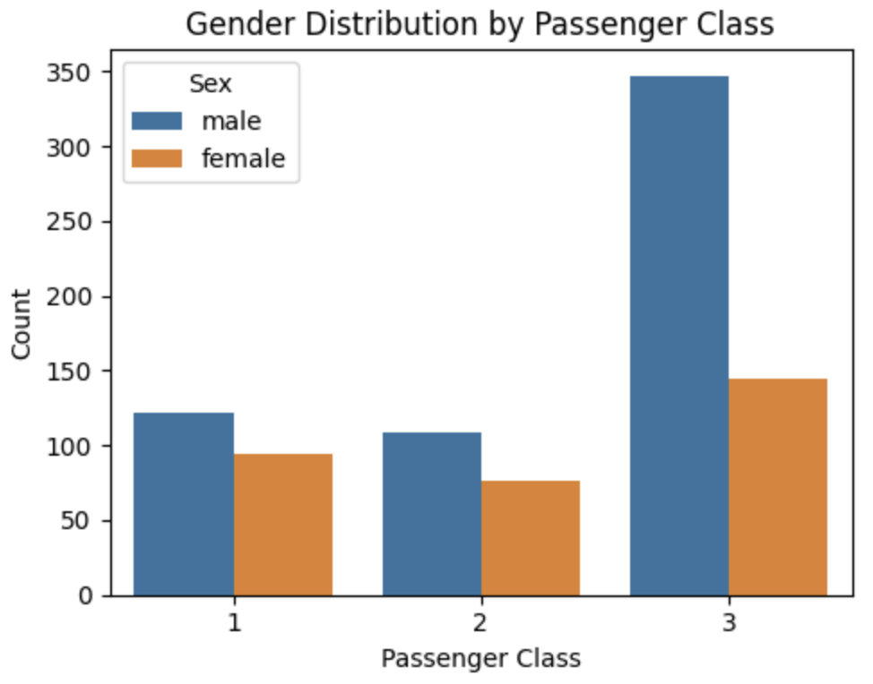
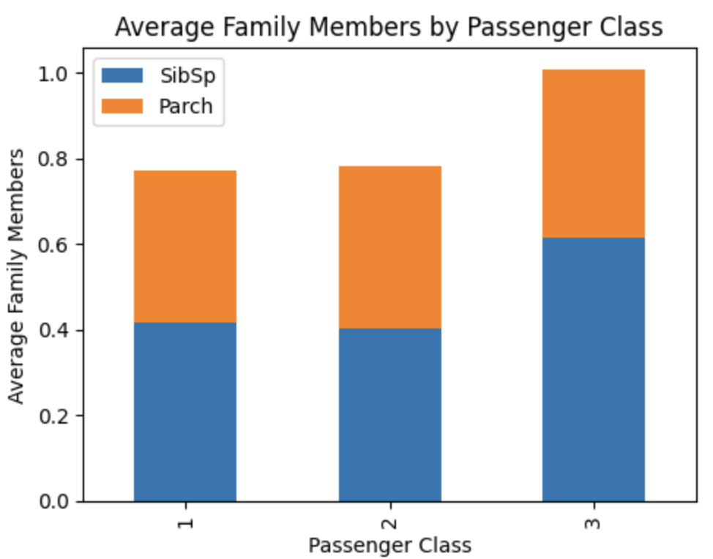
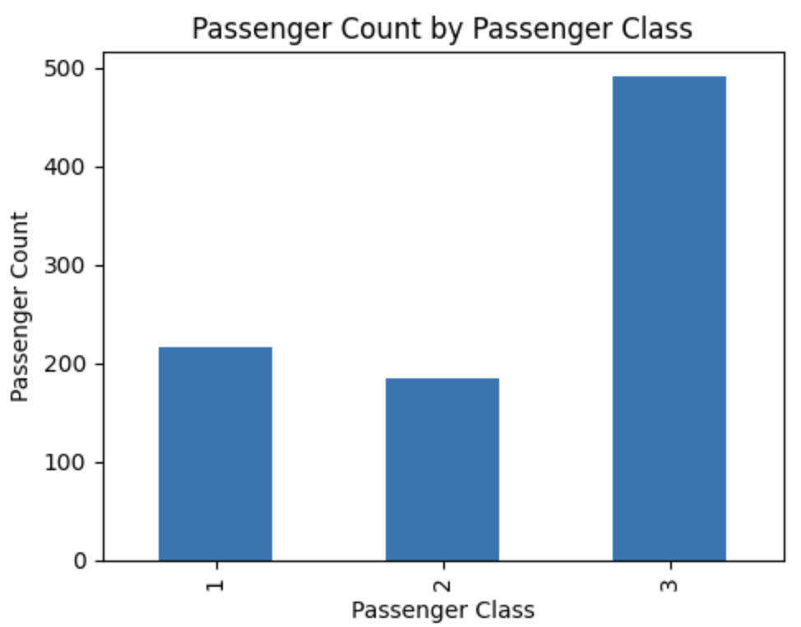
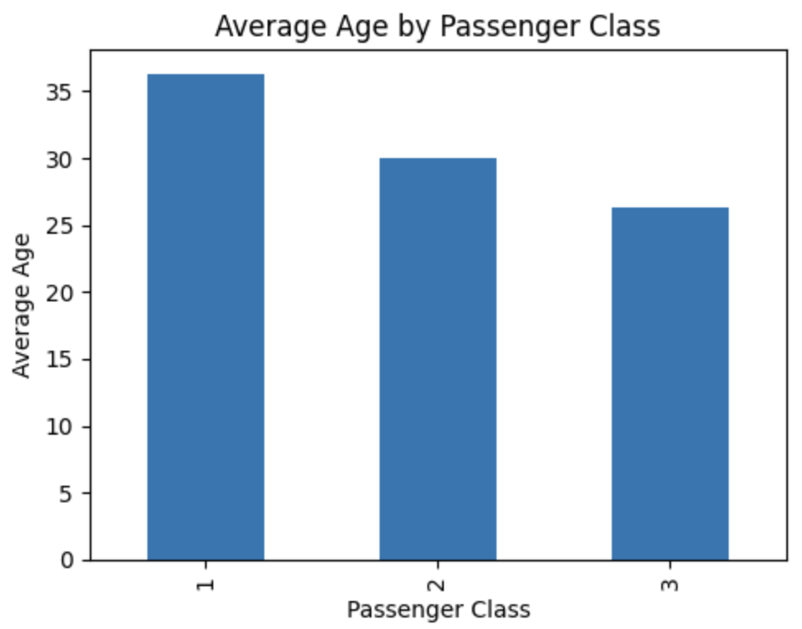
Socio-economic Status Exploration
– Bar plots

Slide 10
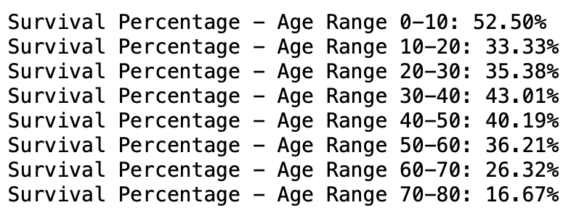
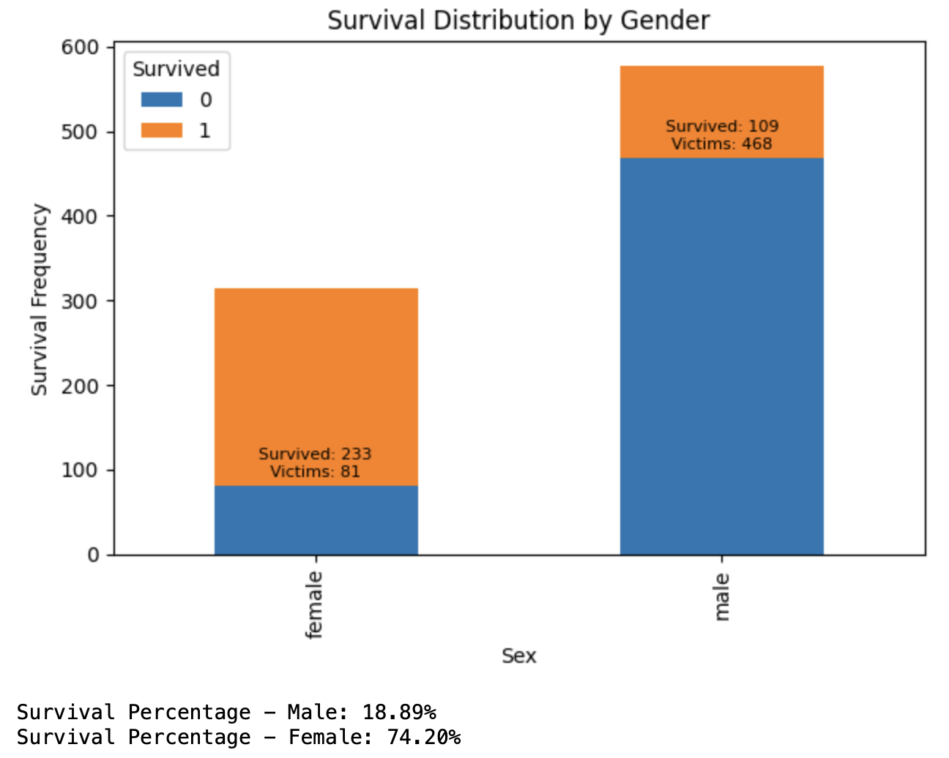
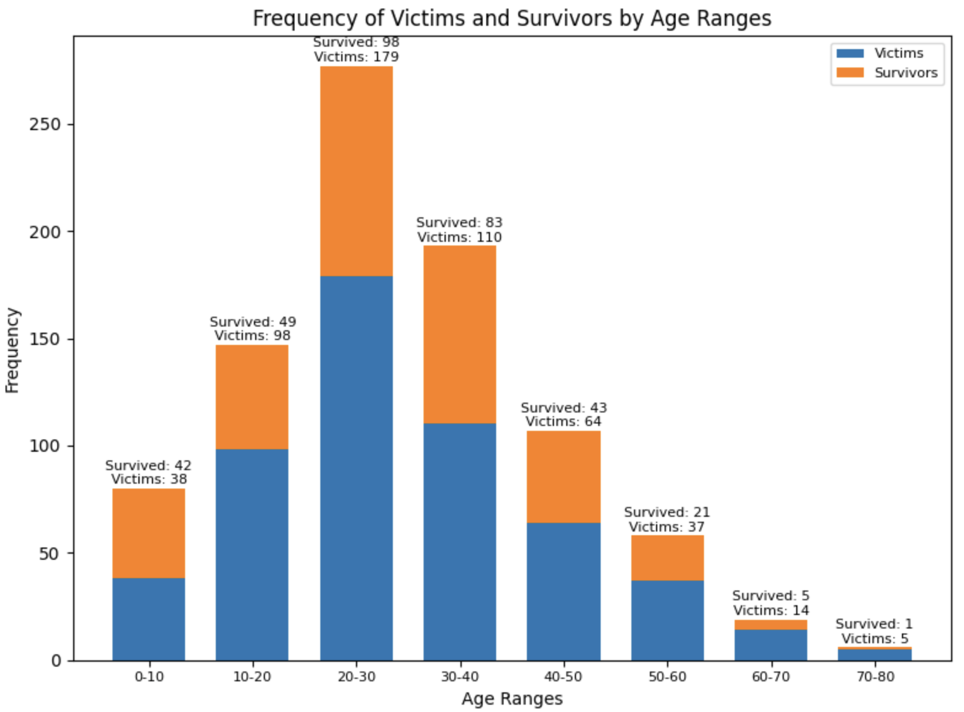
Features Related to Survival
gender/sex
2. age

Slide 11
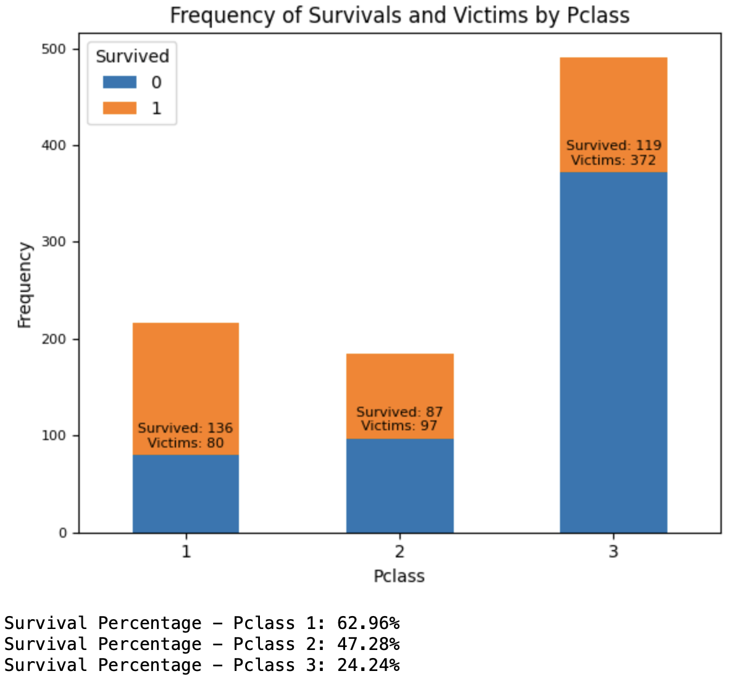
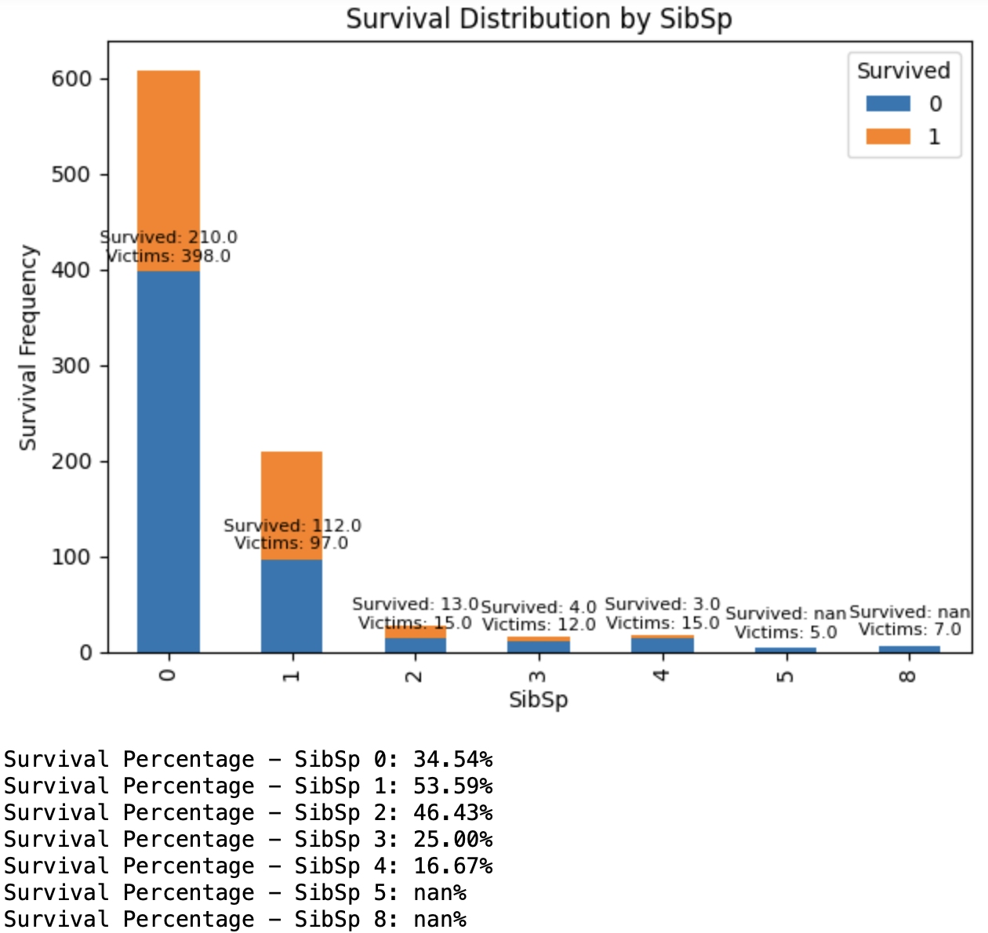
Features Related to Survival
3. passenger class
4. number of siblings/spouses

Slide 12
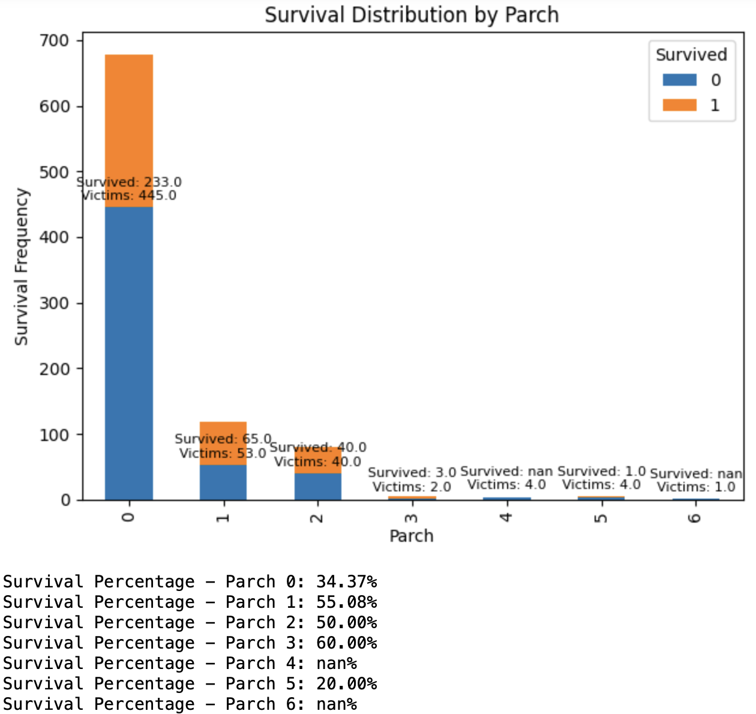
Features Related to Survival
5. number of parents/children

Slide 13
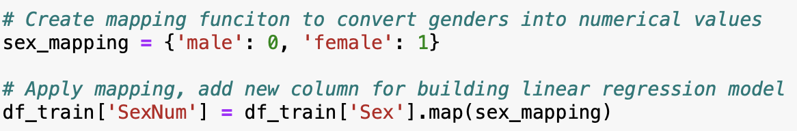
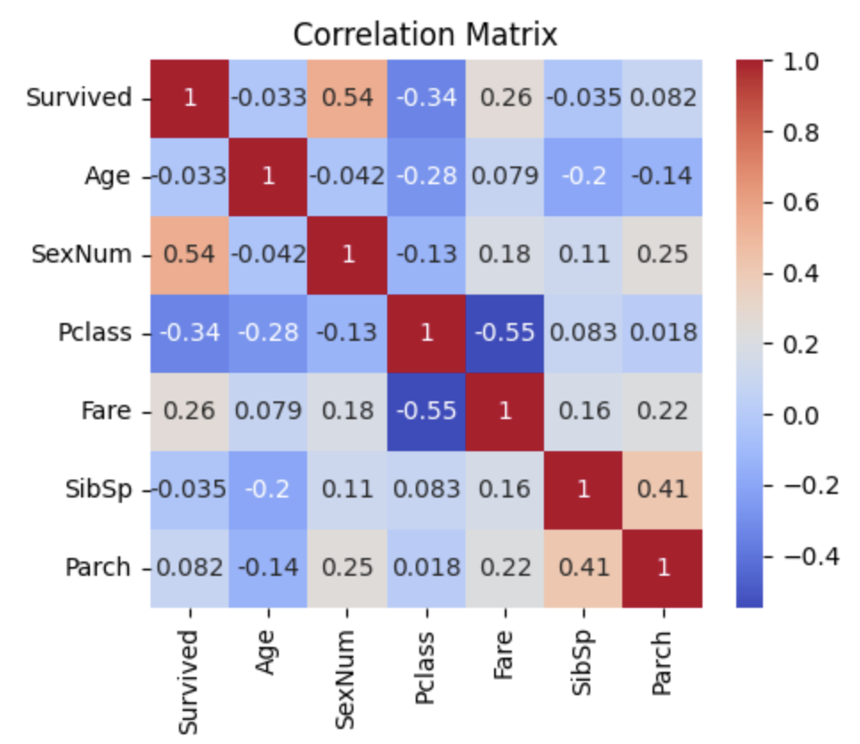
Correlation Analysis
convert the gender column into numerical values(male = 0, female = 1)
compute correlation matrix
plot heat map

Slide 14
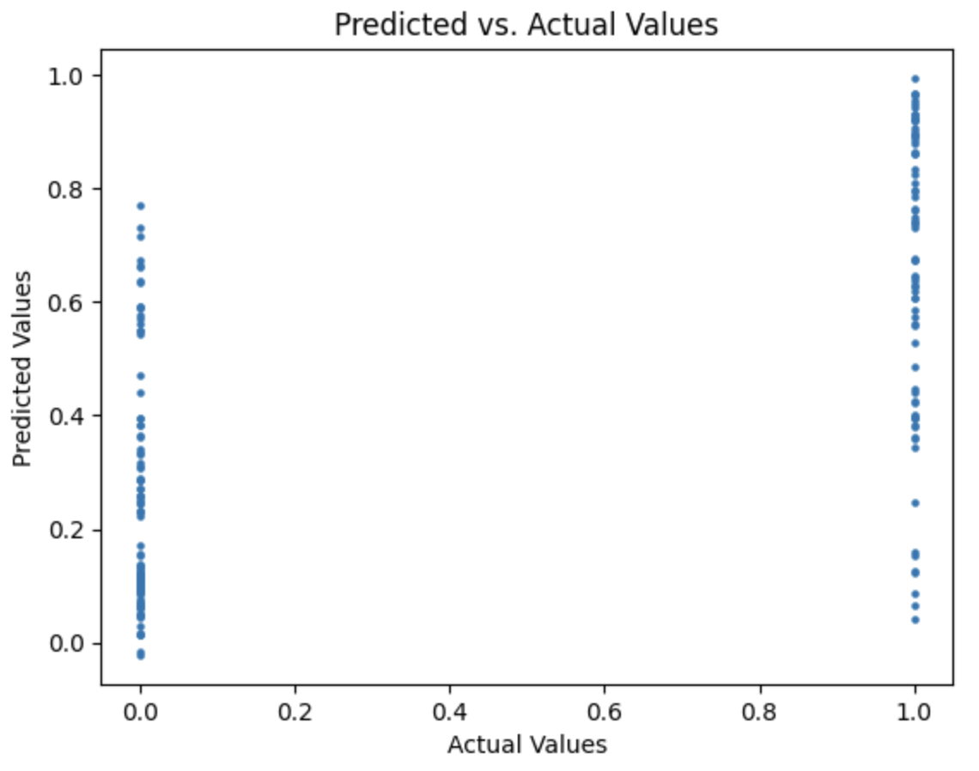
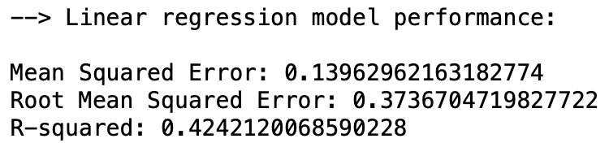
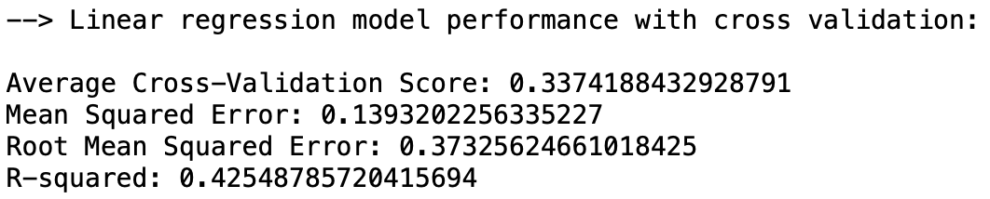
Modeling-linear regression
Performance metrics with and without cross validation:

Slide 15
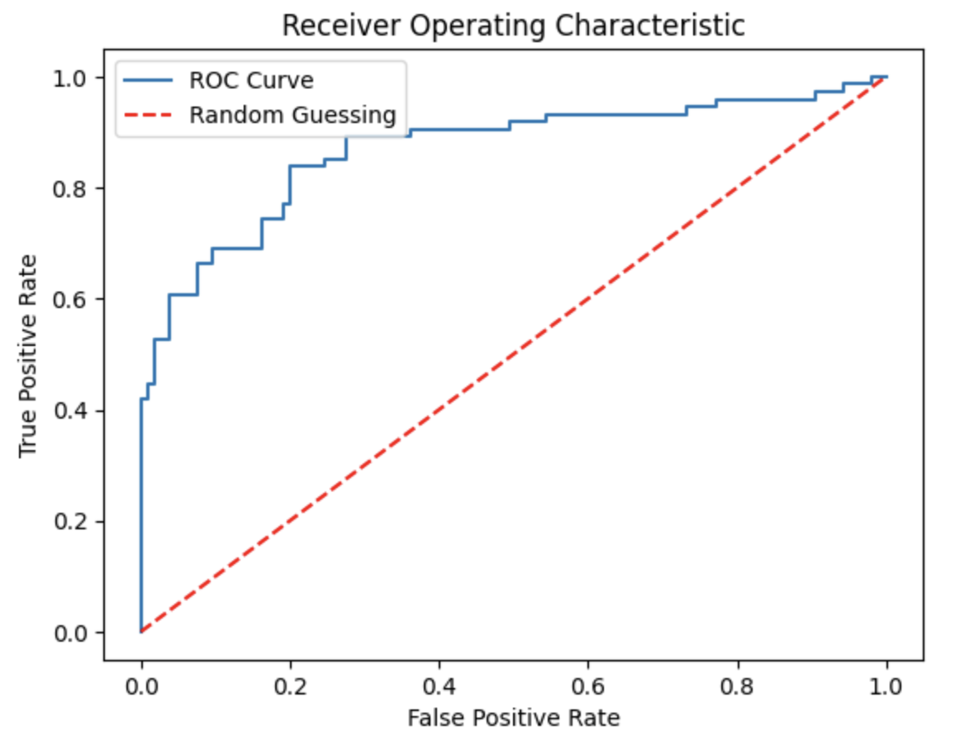
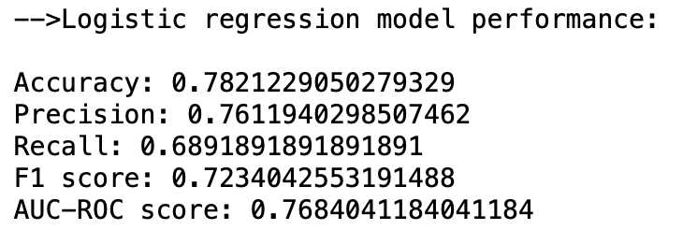
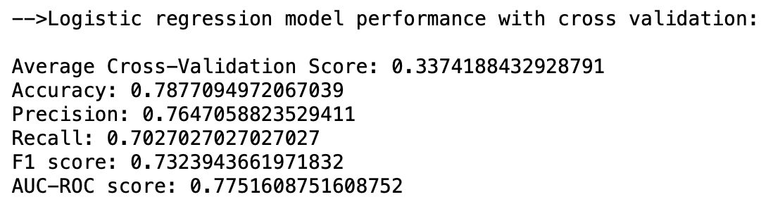
Modeling-logistic regression
Performance metrics with and without cross validation:

Slide 16
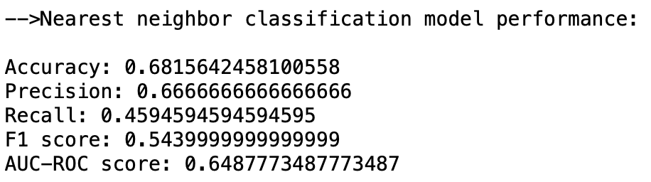
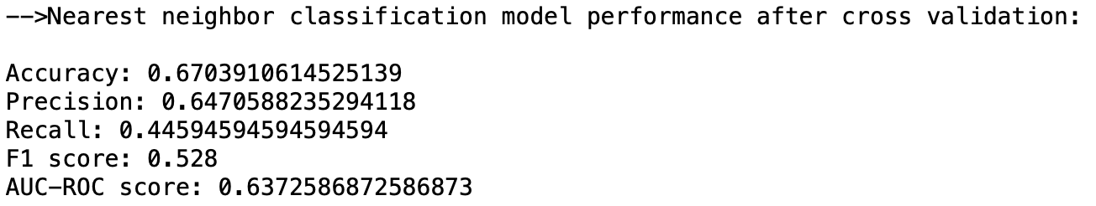
Modeling-K Nearest Neighbors Classification
Performance metrics with and without cross validation when k=3:

Slide 17
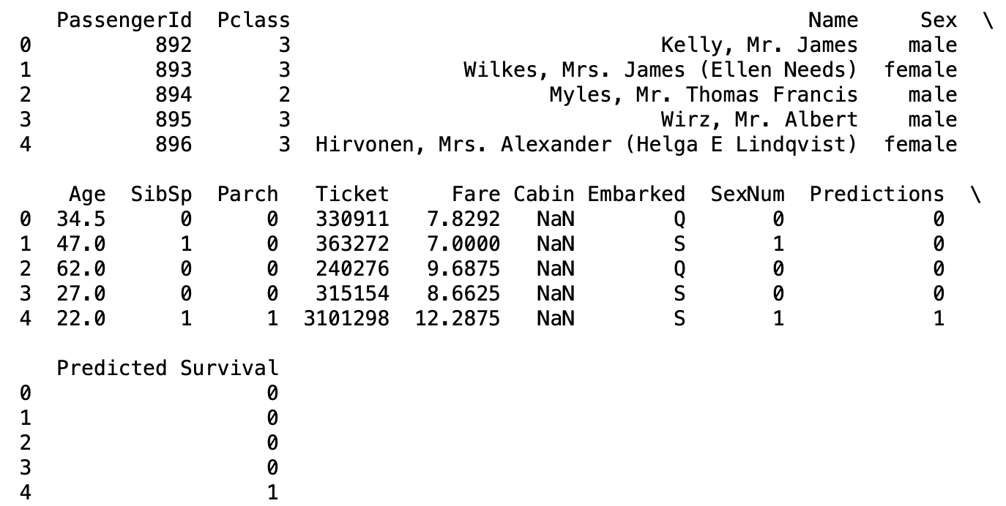
Predictions
– Logistic Model After Cross Validation

